Slide 2
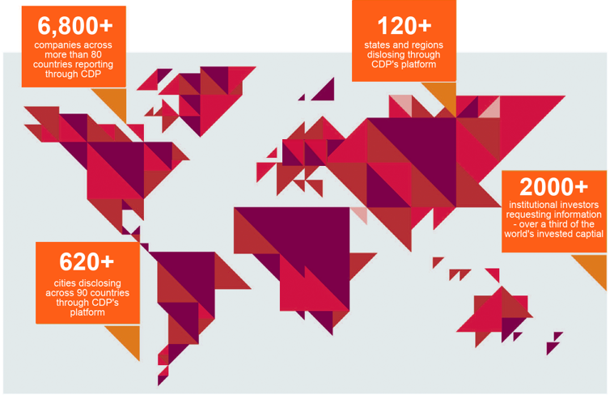
Global environmental disclosure platform

Slide 3
620+ Cities disclosed to us this year
Cities
628
States and regions
573
533
314
207
110
122
73
100
101
48
66
12
2011
2012
2013
2014
2015
2016
2017
2018
Notes:
Number of cities that report each year

Slide 4

Disclosure as a transformative process
Request for information
CDP Action
Establish policies and take action
Answer formulation and submission
City Reaction
Feedback

Slide 5
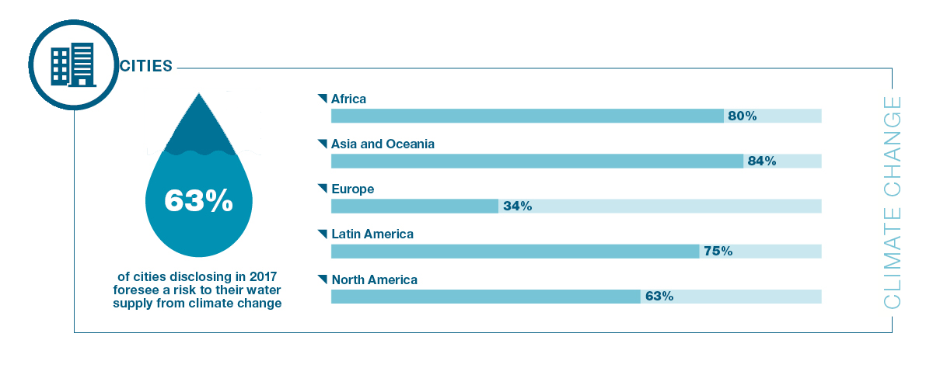
Water is a growing risk for cities
Notes:
Effective water management is escalating up the agenda for cities and companies. These water risks have severe impacts on society and the environment. Cities and companies are identifying availability and quality of water as major risks to their ability to operate and provide for their citizens.

Slide 6
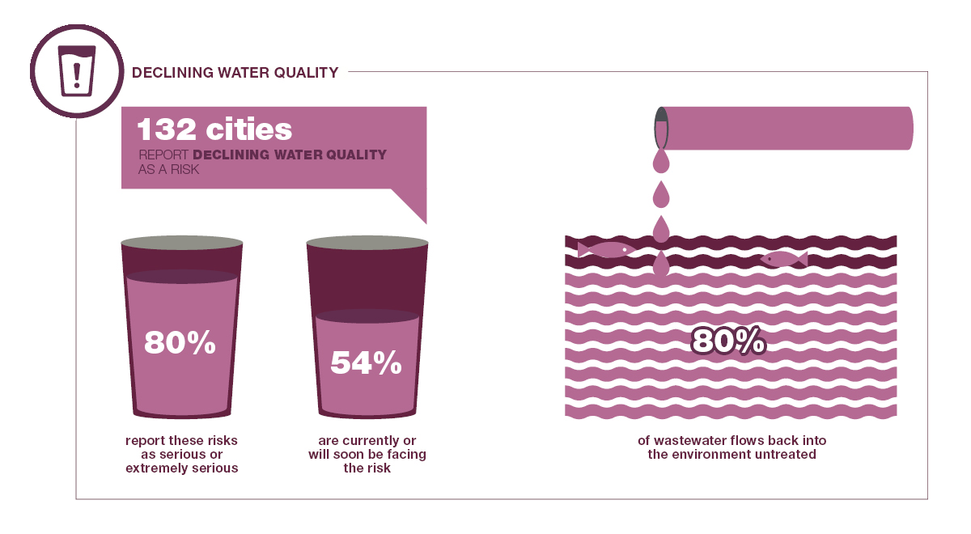
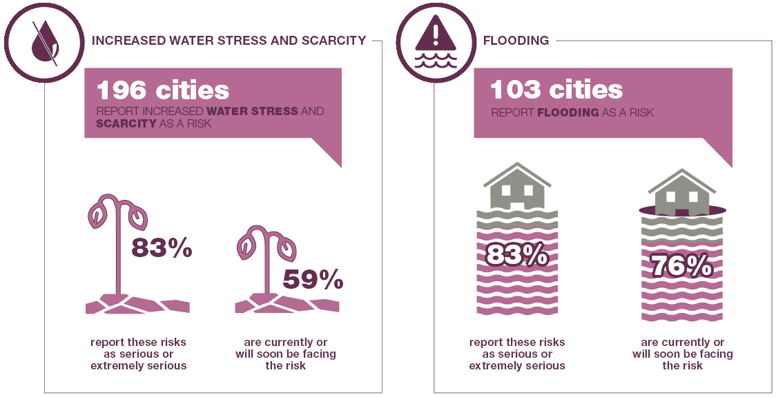
The top three water risks are identified as:
Notes:
Cities and companies are both disclosing these top four water risks:
Declining water quality
132 cities report declining water quality as a risk, of which 80% think it is serious or extremely serious, and 54% are facing the risk currently or in the short-term
Over 80% of wastewater flows back into the environment untreated. Treatment and reuse of this wastewater would help increase the supply of clean water and help meet the growing demand.
Increased water stress and scarcity
196 cities report drought as a risk, of which 83% think it is serious or extremely serious, 59% are facing the risk currently or in the short-term
Flooding
103 cities report flooding as a risk, of which 83% think it is serious or extremely serious, and 76% are facing the risk currently or in the short-term
While cities and companies are identifying water security as an issue, it has been challenging for stakeholders to address it. These risks are not just faced by a city or company alone – but by all water users in the area.
http://www.worldwaterday.org/resources/ On average, high-income countries treat about 70% of the urban wastewater (industrial and municipal) they generate, while that ratio drops to 38% in upper-middle-income countries and to 28% in lower-middle-income countries. In low-income countries, only 8% of industrial and municipal wastewater undergoes treatment of any kind (Sato et. al, 2013; Agricultural Water Management 130: 1-13).

Slide 7
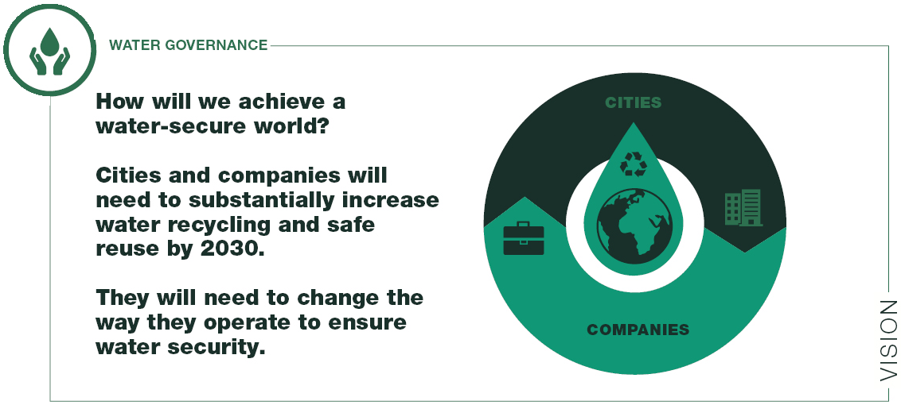
Our vision is to achieve a secure and sustainable water supply by 2030
Notes:
Our VISION is to achieve a secure and sustainable supply of water by 2030, in line with the UN’s Sustainable Development Goal 6.
So, who is in charge of water governance?
Cities and companies will need to substantially increase water recycling and safe reuse by 2030. They will need to change the way they operate to ensure a water-secure world.
Reusing wastewater poses a huge opportunity for companies and cities to reduce their environmental impact, while safeguarding water resources for citizens.

Slide 8
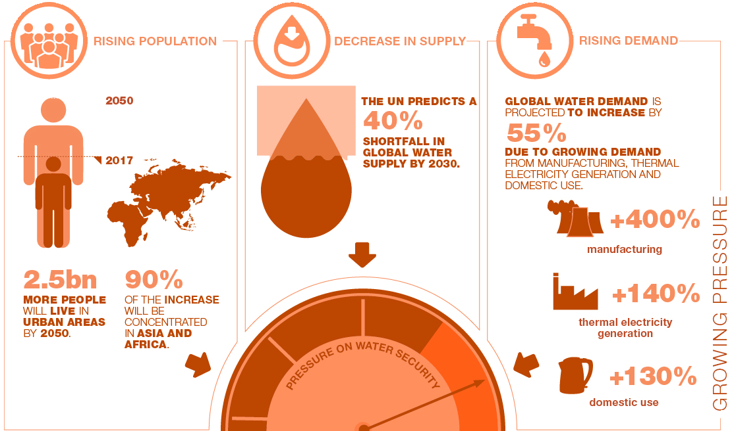
However, there’s a big gap between our vision and reality
Notes:
However, there is a big gap between the vision and reality. And it is getting worse.
Rising population:
With rapid urbanization, cities are facing a growing demand for water, which can lead to mismanagement of water use. These risks translate into an increasing lack of access to clean water for people, most likely in developing countries.
2.5 billion people are projected to add to the world’s urban population by 2050, with nearly 90% of the increase concentrated in Asia and Africa.
The Organisation for Economic Co-operation and Development (OECD) estimates that 4 billion people could be living in water-scarce areas by 2050.
Rising demand:
58% of cities are foreseeing a risk to their water supply. This will be exacerbated by global water demand from companies also increasing
Global water demand is projected to increase by some 55%, due to growing demand from manufacturing (+400%), thermal electricity generation (+140%) and domestic use (+130%)
Decrease in supply:
The UN predicts a 40% global shortfall in water supply by 2030.
Page 5, https://esa.un.org/unpd/wup/publications/files/wup2014-highlights.Pdf
http://reports.weforum.org/global-risks-2016/coping-with-climate-change/
http://www.oecd.org/env/indicators-modelling-outlooks/oecdenvironmentaloutlookto2050theconsequencesofinaction-keyfactsandfigures.htm
http://unesdoc.unesco.org/images/0024/002440/244041e.pdf

Slide 9
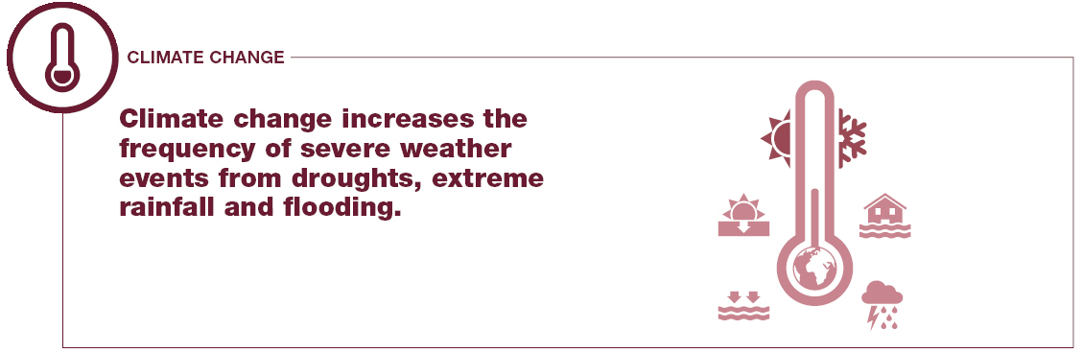
And the gap is getting bigger
Notes:
Climate change increases the frequency of severe weather events from droughts to extreme precipitation and flooding. These events affect water availability and water quality, and are exacerbated by growing populations and increased demand for scarce water resources.

Slide 10
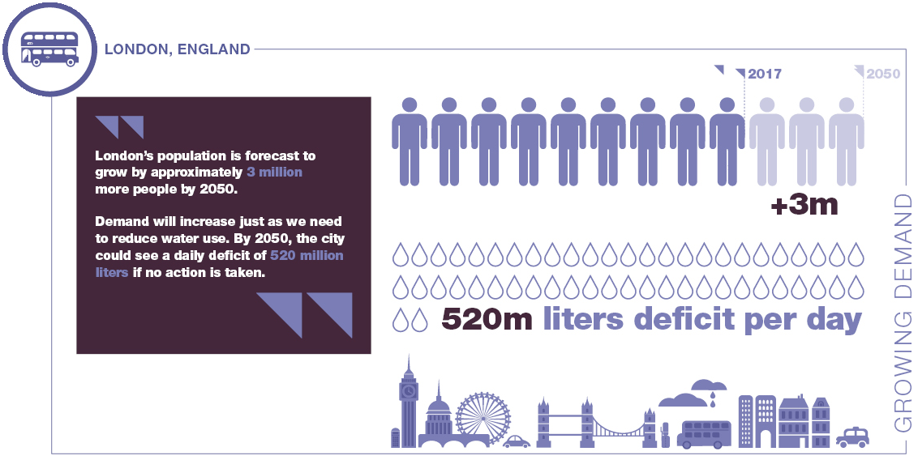
London, England: An example of growing water demand

Slide 11
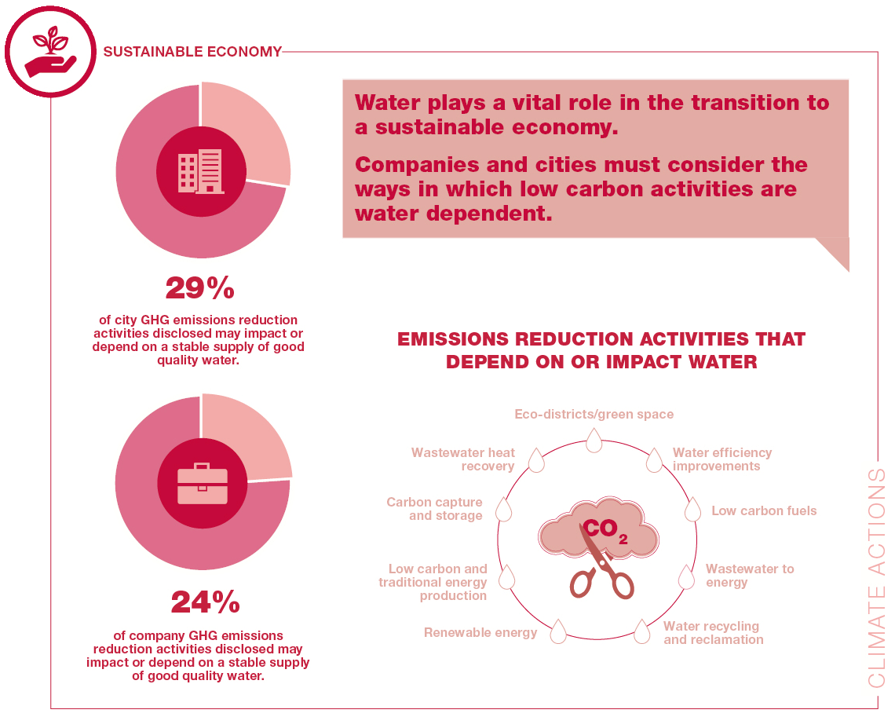
Water is crucial in building our new sustainable economy
Notes:
Water is key for generating the new sustainable economy.
Water plays a vital role in the transition to a low carbon economy.
24% of company GHG emissions reduction activities and 29% of city GHG emissions reduction activities disclosed may impact or depend on a stable supply of good quality water.
Companies and cities must consider the ways in which low carbon activities can be water dependent.
Emissions reduction activities that depend or impact water
Low carbon fuels
Renewable energy
Low carbon and traditional energy production
Carbon capture and storage
Eco-districts/green space
Wastewater to energy
Water recycling and reclamation
Water efficiency improvements
Wastewater heat recovery
Efficient and smart water governance for the global water supply is crucial otherwise there could be severe negative impacts on business operations – and ultimately, people.
Page 6, https://b8f65cb373b1b7b15feb-c70d8ead6ced550b4d987d7c03fcdd1d.ssl.cf3.rackcdn.com/cms/reports/documents/000/001/306/original/CDP-Global-Water-Report-2016.pdf?1484156313

Slide 12
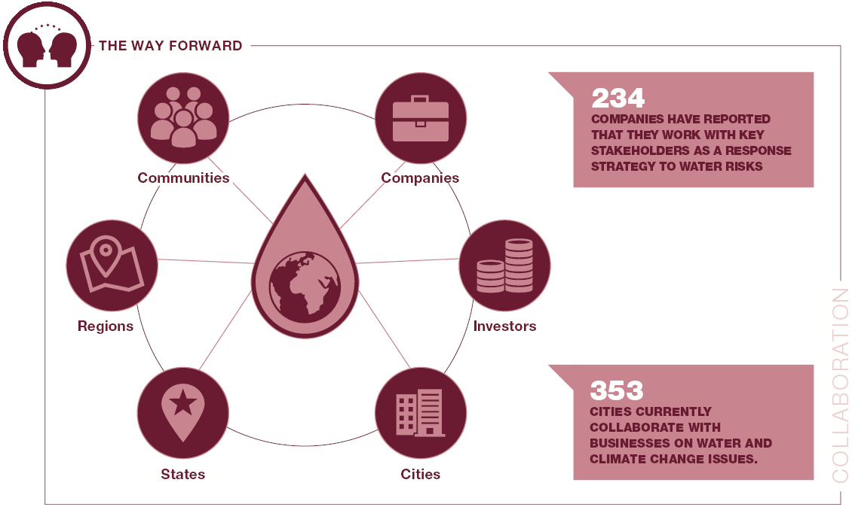
Successful water governance means working together
Notes:
So, what is the solution and who is going to manage it?
Cities and companies are taking action to reduce the impacts of water risks.
Investment in existing water supply infrastructure (102 cities, 165 companies)
Education on conservation awareness (141 cities, 116 companies)
Technology investments to improve water efficiency (112 companies)
Targets: Establish site-specific targets (100 companies)
Diversification of water supply (57 cities, 30 companies)
Management of storm water (87 cities)
Preservation of watershed (49 cities)
The most successful actions will be collaborative between all water users, who are working together to protect this shared resource.
62% of cities currently collaborate with businesses on climate change issues and projects.
73 companies have reported 344 actions that use engagement with other key stakeholders as a response strategy to water risks.

Slide 13
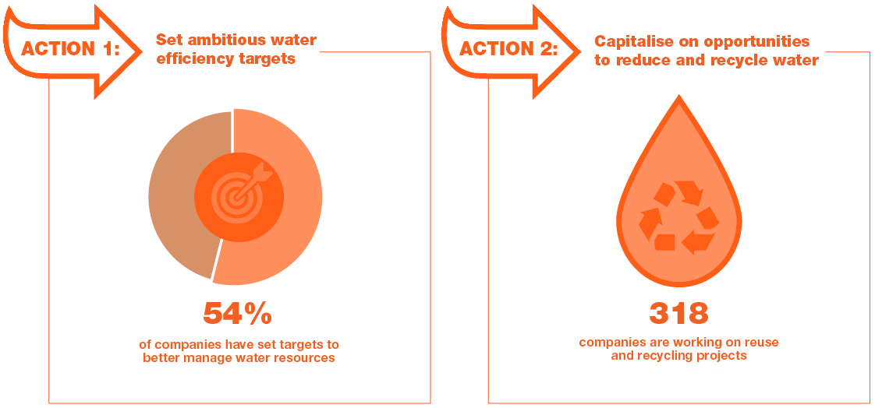
What actions can a city or company take to increase water security?
Notes:
ACTION 1: Cities and companies can set ambitious water targets and goals
54% of companies disclosing to CDP have set both targets and goals to better manage water resources.
ACTION 2: Capitalize opportunities to recycle and reuse water across cities and companies
In 2016, 318 compares disclosed that they were working on reuse and recycling projects.

Slide 14
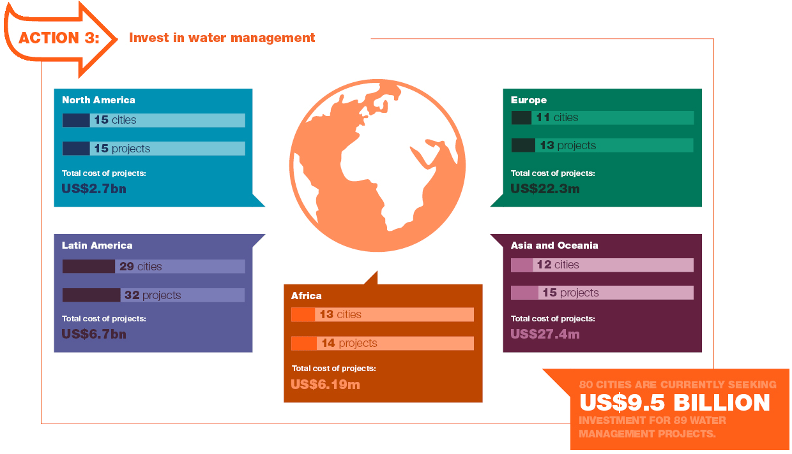
What actions can a city or company take to increase water security?
Notes:
ACTION 3: Companies and cities should work together to invest in water management projects
80 cities (14%) are seeking US$8.2 billion investment in 89 water management projects worth US$9.5 billion.
Africa:
Africa:13 cities (27%) are seeking $10.7 million in 14 water projects worth US$61.9 million
Asia and Oceania:
12 cities (16%) are seeking US$27.4 million in 15 water projects worth US$27.4 million.
Europe:
11 cities (8%) are seeking private sector involvement in 13 water projects worth US$22.3 million
Latin America:
29 cities (19%) are seeking US$6.4 billion in 32 water projects worth US$6.7 billion
North America:
15 cities (10%) are seeking US$1.7 billion in 15 water projects worth US$2.7 billion
Given the right resources and investments, cities can help coordinate this collective action to ensure there is robust water management. Companies can support cities by helping to unlock this financing and help attract investors to these water infrastructure projects.

